Slide 1
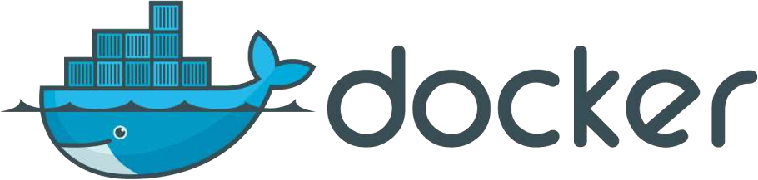
Docker Overview

Slide 2
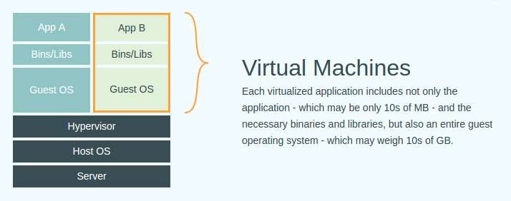
Hardware Virtualization
Virtualizing the Physical Hardware
VMware vSphere Hypervisor
Xen
KVM
VirtualBox

Slide 3
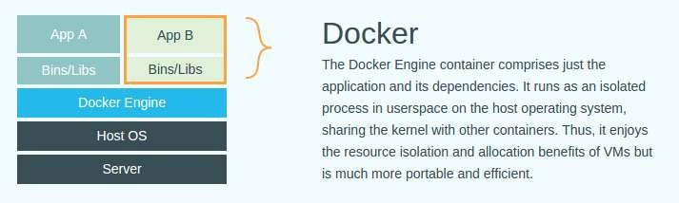
OS Virtualization
Virtualizing the Operating System
Containers have existed on *nix systems for some time
An extension of the 'chroot‘ concept
Examples:
Linux Containers
BSD “Jails”
Solaris Containers
“Understanding Docker”: https://docs.docker.com/introduction/understanding-docker/

Slide 4
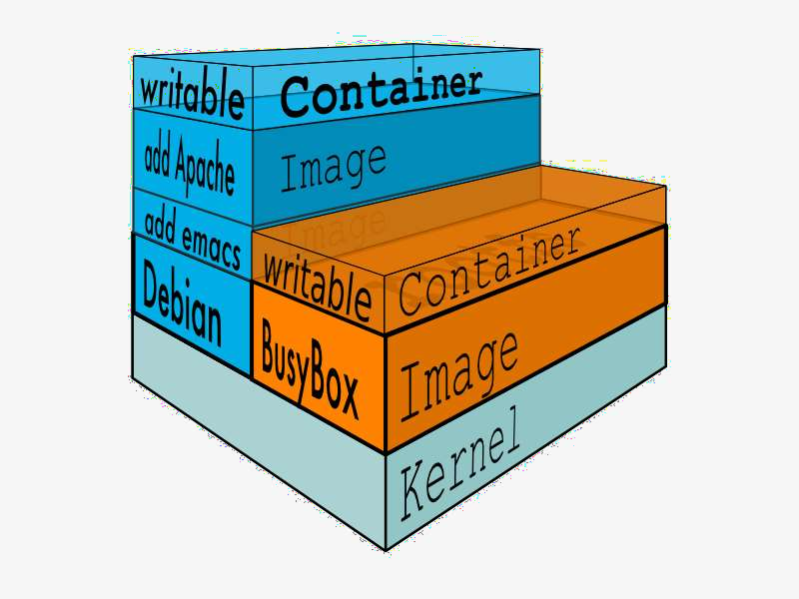
What is Docker?
Docker helps to create and manage containers easy
Docker creates an ecosystem similar to Github and Maven that makes
it easy to share images
An image is a shareable snapshot of software
A container is a running instance of an image
Images can be built and managed on your local workstation
Images can be pulled and pushed from private and public repos
What is Docker? https://www.docker.com/whatisdocker/

Slide 5
Currently Linux-Centric
Linux already has container support
Container support is already in Linux
Uses Linux namespaces and control groups (cgroups)
So, what does Docker bring to the table?
makes it easy to build images
creates images that are portable
provides an ecosystem to help users share their images
Shared Registry
is open-source
has a very active community
provides security

Slide 6
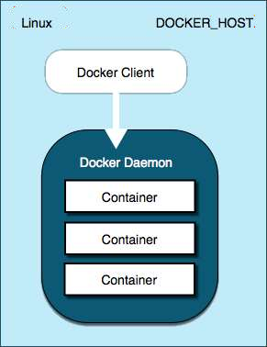
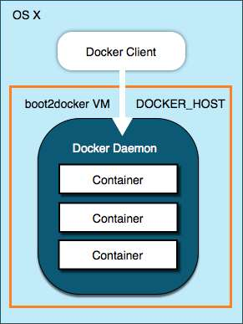
What About Mac OS?
Can run Docker under Mac OS!
Until native OS support is built – Use 'boot2docker'
Full instructions: https://docs.docker.com/installation/mac/
boot2docker runs a lightweight VM that hosts the Docker daemon
Docker daemon is native under Linux

Slide 7
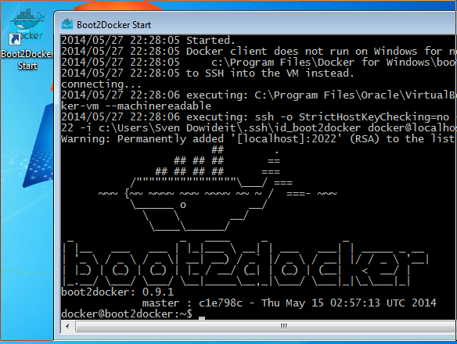
What About Windows?
Can run Docker under Windows
Until native OS support is built – Use 'boot2docker'
Uses the standard Windows
installer
Startup screen looks like this:
See instructions at: https://docs.docker.com/installation/windows

Slide 8
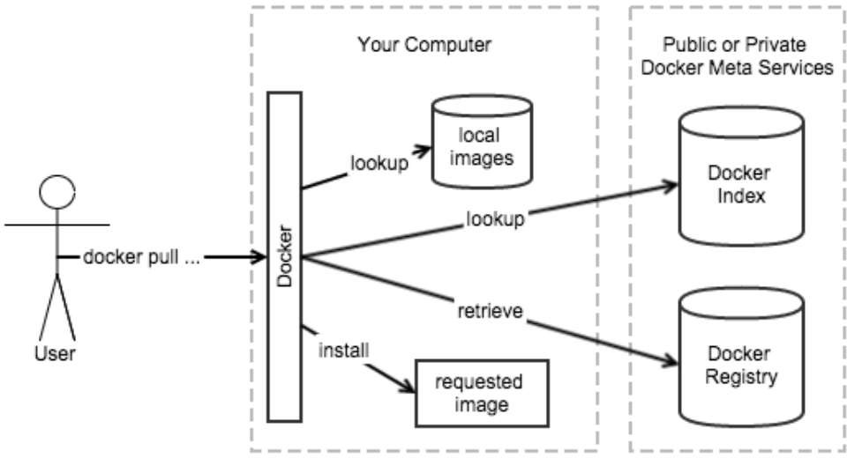
Docker Ecosystem
Docker provides a centralized repository of Images
http://registry.hub.docker.com
3rd Party private repos are available too
Or set up your own on-prem repos
Similar to Github & Maven
Diagrams from “Docker in Action”, Manning Publications

Slide 9
Demo: Install Docker
https://docs.docker.com/installation/ubuntulinux/
Use the “Docker-maintained Package Installation” section
For the latest version of Docker
Check for HTTPS transport for apt:
sudo apt-get update
sudo apt-get install apt-transport-https
Create a new apt sources file – docker.list sudo vi /etc/apt/sources.d/docker.list and add the following line:
deb https://get.docker.com/ubuntu docker main
Finish the incantation with an update and an install:
sudo apt-get update
sudo apt-get install lxc-docker
And you’re done!
For other distros: https://docs.docker.com/installation/

Slide 10
Demo: Find Images
For a web interface: https://registry.hub.docker.com/
Or you can search for images using the CLI:
sudo docker search busybox
Stars indicate the popularity of the image
Official [OK] indicate if the image is built/maintained by Docker.com
peterc@L4377743:~$ sudo docker [sudo] password for peterc: | search busybox
NAME busybox | DESCRIPTION Busybox base image. |  |  |  |  |  | STARS 135 | OFFICIAL [OK] | AUTOMATED
progrium/busybox |  |  |  |  |  |  | 36 |  | [OK]
jeanblanchard/busybox-java | Minimal Docker image with Java |  |  |  |  |  | 21 |  | [OK]
jeanblanchard/busybox-tomcat | Minimal Docker image with Apache Tomcat |  |  |  |  |  | 10 |  | [OK]
radial/busyboxplus | Full-chain, Internet enabled, busybox made... |  |  |  |  |  | 4 |  | [OK]
sequenceiq/busybox |  |  |  |  |  |  | 1 |  | [OK]
peelsky/zulu-openjdk-busybox |  |  |  |  |  |  | 1 |  | [OK]
skomma/busybox-data | Docker image suitable for data volume cont... |  |  |  |  |  | 1 |  | [OK]
alars/busybox-go-webapp … justicefries/busybox-ssl | Busybox, with SSL support |  |  |  |  |  | 0 0 |  | [OK] [OK]
… shingonoide/archlinux-busybox | Arch Linux, a lightweight and flexible Lin... |  |  |  |  |  | 0 |  | [OK]
openshift/busybox-http |  |  |  |  |  |  | 0 |  | [OK]
ggtools/busybox-ubuntu | Busybox | ubuntu | version | with | extra | goodies | 0 | [OK]
akolosov/busybox |  |  |  |  |  |  | 0 | [OK]
socketplane/busybox |  |  |  |  |  |  | 0 | [OK]
powellquiring/busybox |  |  |  |  |  |  | 0 | [OK]
openshift/busybox-http-app peterc@L4377743:~$ |  |  |  |  |  |  | 0 | [OK]

Slide 11
Demo: Trusted Images
“Official” Docker images
https://registry.hub.docker.com/search?q=library&searchfield=
or via CLI:
peterc@L4377743:~$ NAME AUTOMATED ubuntu | sudo | docker | search | library DESCRIPTION Official Ubuntu base image | STARS 1404 | OFFICIAL [OK]
centos |  |  |  | The official build of CentOS. | 865 | [OK]
nginx |  |  |  | Official build of Nginx. | 646 | [OK]
node |  |  |  | Node.js is a JavaScript-based platform for... | 559 | [OK]
postgres |  |  |  | The PostgreSQL object-relational database ... | 554 | [OK]
redis |  |  |  | Redis is an open source key-value store th... | 547 | [OK]
mysql |  |  |  | MySQL is a widely used, open-source relati... | 507 | [OK]
mongo |  |  |  | MongoDB document databases provide high av... | 478 | [OK]
debian |  |  |  | (Semi) Official Debian base image. | 368 | [OK]
jenkins |  |  |  | Official Jenkins Docker image | 284 | [OK]
wordpress |  |  |  | The WordPress rich content management syst... | 234 | [OK]
registry |  |  |  | Containerized docker registry | 204 | [OK]
golang |  |  |  | Go (golang) is a general purpose, higher-l... | 166 | [OK]
rails |  |  |  | Rails is an open-source web application fr... | 144 | [OK]
fedora |  |  |  | Official Fedora 21 base image and semi-off... | 144 | [OK]
busybox |  |  |  | Busybox base image. | 142 | [OK]
python |  |  |  | Python is an interpreted, interactive, obj... | 138 | [OK]
java |  |  |  | Java is a concurrent, class-based, and obj... | 137 | [OK]
php |  |  |  | While designed for web development, the PH... | 136 | [OK]
ruby |  |  |  | Ruby is a dynamic, reflective, object-orie... | 133 | [OK]
tomcat |  |  |  | Apache Tomcat is an open source implementa... | 77 | [OK]
perl |  |  |  | Perl is a high-level, general-purpose, int... | 29 | [OK]
ubuntu-upstart |  |  |  | Upstart is an event-based replacement for ... | 21 | [OK]
peterc@L4377743:~$

Slide 12
Demo: Running an Image
First time you ‘run’ an image, you download the image The image, once running, is called a ‘container’
peterc@L4377743:~$ sudo docker run -ti busybox:latest
/ # ls -alp total 56 | /
drwxr-xr-x | 24 | root | root | 4096 | Feb | 27 | 19:32 | ./
drwxr-xr-x | 24 | root | root | 4096 | Feb | 27 | 19:32 | ../
-rwxr-xr-x | 1 | root | root | 0 | Feb | 27 | 19:32 | .dockerenv
-rwxr-xr-x | 1 | root | root | 0 | Feb | 27 | 19:32 | .dockerinit
drwxrwxr-x | 2 | root | root | 4096 | May | 22 | 2014 | bin/
drwxr-xr-x | 5 | root | root | 380 | Feb | 27 | 19:32 | dev/
drwxr-xr-x | 6 | root | root | 4096 | Feb | 27 | 19:32 | etc/
drwxrwxr-x | 4 | root | root | 4096 | May | 22 | 2014 | home/
drwxrwxr-x | 2 | root | root | 4096 | May | 22 | 2014 | lib/
lrwxrwxrwx | 1 | root | root | 3 | May | 22 | 2014 | lib64 -> lib/
lrwxrwxrwx | 1 | root | root | 11 | May | 22 | 2014 | linuxrc -> bin/busybox
drwxrwxr-x | 2 | root | root | 4096 | Feb | 27 | 2014 | media/
drwxrwxr-x | 2 | root | root | 4096 | Feb | 27 | 2014 | mnt/
drwxrwxr-x | 2 | root | root | 4096 | Feb | 27 | 2014 | opt/
dr-xr-xr-x | 321 | root | root | 0 | Feb | 27 | 19:32 | proc/
drwx------ | 2 | root | root | 4096 | Feb | 27 | 19:32 | root/
lrwxrwxrwx | 1 | root | root | 3 | Feb | 27 | 2014 | run -> tmp/
drwxr-xr-x | 2 | root | root | 4096 | May | 22 | 2014 | sbin/
dr-xr-xr-x | 13 | root | root | 0 | Feb | 27 | 19:32 | sys/
drwxrwxrwt | 3 | root | root | 4096 | May | 22 | 2014 | tmp/
drwxrwxr-x | 6 | root | root | 4096 | May | 22 | 2014 | usr/
drwxrwxr-x / # exit | 4 | root | root | 4096 | May | 22 | 2014 | var/
peterc@L4377743:~$ su CONTAINER ID |  |  | do docker ps -a IMAGE | COMMAND |  |  | CREATED |  | STATUS PORTS
NAMES 3bc3868dd6aa |  |  | busybox:latest | "/bin/sh" |  |  | 15 minutes ago |  | Exited (0) 8 seconds ago
cocky_wilson peterc@L4377743:~$

Slide 13
Demo: Help
At this point, you’re wondering: “How do I remember all this?”
peterc@L4377743:~$ docker help
…
… Commands:
attach build commit cp create diff events exec export history images import info inspect kill load login logout logs port pause ps pull push rename restart rm
rmi run
Attach to a running container Build an image from a Dockerfile
Create a new image from a container's changes
Copy files/folders from a container's filesystem to the host path Create a new container
Inspect changes on a container's filesystem Get real time events from the server
Run a command in a running container
Stream the contents of a container as a tar archive
Show the history of an image List images
Create a new filesystem image from the contents of a tarball Display system-wide information
Return low-level information on a container or image Kill a running container
Load an image from a tar archive
Register or log in to a Docker registry server Log out from a Docker registry server
Fetch the logs of a container
Lookup the public-facing port that is NAT-ed to PRIVATE_PORT Pause all processes within a container
List containers
Pull an image or a repository from a Docker registry server Push an image or a repository to a Docker registry server Rename an existing container
Restart a running container Remove one or more containers Remove one or more images
Run a command in a new container
…

Slide 14
Demo: Help
And you can get extensive help on each command:
peterc@L4377743:~$ docker help run
Usage: docker run [OPTIONS] IMAGE [COMMAND] [ARG...]
Run a command in a new container
-a, --attach=[]
--add-host=[]
-c, --cpu-shares=0
--cap-add=[]
--cap-drop=[]
--cidfile=""
--cpuset=""
-d, --detach=false
--device=[]
--dns=[]
--dns-search=[] domain)
-e, --env=[]
--entrypoint=""
--env-file=[]
--expose=[]
publishing it to your host
-h, --hostname=""
…
Attach to STDIN, STDOUT or STDERR.
Add a custom host-to-IP mapping (host:ip) CPU shares (relative weight)
Add Linux capabilities
Drop Linux capabilities
Write the container ID to the file
CPUs in which to allow execution (0-3, 0,1)
Detached mode: run the container in the background and print the new container ID Add a host device to the container (e.g. --device=/dev/sdc:/dev/xvdc:rwm)
Set custom DNS servers
Set custom DNS search domains (Use --dns-search=. if you don't wish to set the search
Set environment variables
Overwrite the default ENTRYPOINT of the image
Read in a line delimited file of environment variables
Expose a port or a range of ports (e.g. --expose=3300-3310) from the container without
Container host name
All the command details are available in the Docker website docs:
https://docs.docker.com/reference/commandline/cli/

Slide 15
Demo: node.js + redis app
Let’s spin up a node.js & redis app:
Arbitrarily picked nodejs-todo app off github for this demo
It uses these modules: ejs, express, underscore, and of course, redis
1. Start a redis instance
Run in detached mode
Give it a name so it’s easy to link
peterc@L4377743:~$ sudo docker run –d --name redis redis:latest fb173fb5194afa5fbeaa24d2acf1b6f9dd8e72cfefa6088ff3b3e4e9b3059c66 peterc@L4377743:~$
No port specified. Never needs to communicate outside containers
2. Check for the running container
peterc@L4377743:~$ sudo docker ps -a [sudo] password for peterc:
CONTAINER ID NAMES
fb173fb5194a
6379/tcp 3bc3868dd6aa cocky_wilson peterc@L4377743:~$
IMAGE
COMMAND
CREATED
STATUS
PORTS
redis:latest redis busybox:latest
"redis-server /etc/r
About an hour ago
Up About an hour
"/bin/sh"
4 hours ago
Exited (0) 4 hours ago
We did not specify a port on the ‘run’ command
Default port for redis is 6379
All networking access is explicit; it has to be specified on ‘run’ if it’s required Try ‘netstat’ or ‘telnet’… No 6379 port listening.

Slide 16
Demo: node.js + redis app
The redis container is now up and running
Let’s get a sample node.js app to run and use the redis database
Get nodejs-todo
peterc@L4377743:~/tmp$ git clone https://github.com/amirrajan/nodejs-todo.git Cloning into 'nodejs-todo'...
remote: Counting objects: 32, done.
remote: Total 32 (delta 0), reused 0 (delta 0), pack-reused 32 Unpacking objects: 100% (32/32), done.
Checking connectivity... done.
peterc@L4377743:~/tmp$
Examine source. Make a one-line modification
peterc@L4377743:~/tmp/nodejs-todo$ vi server.js peterc@L4377743:~/tmp/nodejs-todo$ git diff server.js diff --git a/server.js b/server.js
index 20263cd..59323fe 100644
--- a/server.js
+++ b/server.js
@@ -11,7 +11,7 @@ var client = null; if(process.env.REDISTOGO_URL) { //heroku
client = require('redis-url').connect(process.env.REDISTOGO_URL);
} else if(config.env == "development") {
- client = redis.createClient();
+ client = redis.createClient(secret.redisPort, secret.redisMachine);
} else { //nodejitsu
client = redis.createClient(secret.redisPort, secret.redisMachine);
client.auth(secret.redisAuth, function (err) { peterc@L4377743:~/tmp/nodejs-todo$

Slide 17
Demo: node.js + redis app
There are a couple of code changes needed so that the app runs under Docker
First, the nodejs-todo needs one dependency update…
5. Modify package.json
(Lock in express version 3.0.1, since newer versions require code changes)
peterc@L4377743:~/tmp/nodejs-todo$ git diff package.json diff --git a/package.json b/package.json
index 39bd9de..052ecff 100644
--- a/package.json
+++ b/package.json @@ -11,7 +11,7 @@
"url": "git://github.com/amirrajan/nodejs-todo.git"
},
"dependencies": {
- "express": "~3.0.1",
"express": "3.0.1",
"ejs": "~0.8.3",
"jasmine-node": "~1.0.26",
"underscore": "~1.4.2",
+
peterc@L4377743:~/tmp/nodejs-todo$

Slide 18
Demo: node.js + redis app
When we start the node container, it will need to connect with redis
There are many ways to do this
Let’s use the Docker CLI to get the redis IP address
Get redis container’s IP address
peterc@L4377743:~/tmp/nodejs-todo$ export DOCKER_IP=`sudo docker inspect --format='{{.NetworkSettings.IPAddress}}' \
> fb173fb5194a`
peterc@L4377743:~/tmp/nodejs-todo$ echo $DOCKER_IP 172.17.0.2
peterc@L4377743:~/tmp/nodejs-todo$
Set up nodejs-todo’s configuration file
peterc@L4377743:~/tmp/nodejs-todo$ sed -e "s/\"redisMachine\": \"\",/\"redisMachine\": \"$DOCKER_IP\",/" \
lib/secret.js.example > lib/secret.js peterc@L4377743:~/tmp/nodejs-todo$ cat lib/secret.js module.exports = {
"redisPort": 6379,
"redisMachine": "172.17.0.2", "redisAuth": "",
};
peterc@L4377743:~/tmp/nodejs-todo$
Now the nodejs-todo app is ready to go
(Note that all of this is easily scriptable.)

Slide 19
Demo: node.js + redis app
Now let’s fire up the node.js container
We’ll bring it up as a terminal session, so you can see its internals That will also allow us to install the ‘required’ modules
Since the generic node.js container doesn’t know anything about the nodejs-todo app We’ll inject that app into the container when we start it
Interactive terminal session
8. Start node.js container
Expose port 3000 (as 3000)
Place node app under /opt folder
peterc@L4377743:~/tmp/nodejs-todo$ sudo docker run -ti -p 3000:3000 -v ~/tmp/nodejs-todo:/opt/nodejs-todo \
--link redis:redis library/nodejs:0.10.36 /bin/bash
bash: -e: command not found
[ root@4b47ff312f4a:/data ]$ cd /opt/nodejs-todo
[ root@4b47ff312f4a:/opt/nodejs-todo {master *} ]$ cat lib/secret.js
module.exports = {
"redisPort": 6379,
"redisMachine": "172.17.0.2", "redisAuth": "",
};
The --link option links this node container to the already running redis container.
Does the secret.js file look familiar?
We’re now accessing it inside the container.

Slide 20
Demo: node.js + redis app
Starting the node.js container, continued…
The node.js container is now running
But before we start the node server, nodejs-todo requires 4 modules
Installing the app’s node dependencies in the container
root@595627a55592:/# cd /opt/nodejs-todo/ root@595627a55592:/opt/nodejs-todo# npm install underscore@1.4.4 node_modules/underscore
ejs@0.8.8 node_modules/ejs redis@0.8.6 node_modules/redis
jasmine-node@1.0.28 node_modules/jasmine-node
├── walkdir@0.0.7
├── coffee-script@1.9.1
├── requirejs@2.1.16
└── jasmine-reporters@2.0.5 (mkdirp@0.3.5)
express@3.0.1 node_modules/express
├── methods@0.0.1
├── fresh@0.1.0
├── cookie-signature@0.0.1
├── range-parser@0.0.4
├── cookie@0.0.4
├── crc@0.2.0
├── commander@0.6.1
├── mkdirp@0.3.3
├── debug@2.1.2 (ms@0.7.0)
├── send@0.1.0 (mime@1.2.6)
└── connect@2.6.2 (pause@0.0.1, bytes@0.1.0, formidable@1.0.11, qs@0.5.1) root@595627a55592:/opt/nodejs-todo#
Start the server
[ root@4b47ff312f4a:/opt/nodejs-todo {master *} ]$ node server.js

Slide 21
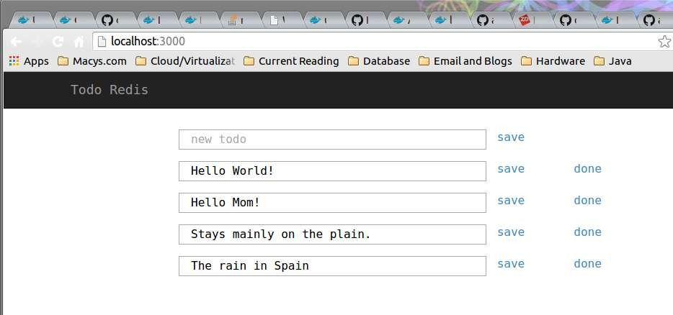
Demo: node.js + redis app
The node.js container is now running the nodejs-todo app We can now run the app in a browser
10. Start browser on localhost:3000
Play around. Stop the node container. Restart it. The redis data is still there!

Slide 22
New Docker Features in Development

Slide 23
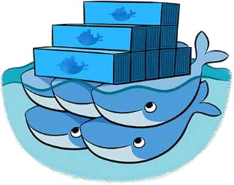
Docker Swarm
Run many containers as a cluster
Turns pool of Docker hosts into a single, virtual host
Swarm uses the existing Docker API
Pluggable backends
Allows swapping with more powerful backends
For example: Mesos
TLS support for all server communications
CLI to Swarm
Swarm to Docker nodes
https://github.com/docker/swarm/

Slide 24
Docker Machine
Makes Docker host creation much easier
Works on:
Local laptop
On cloud providers
In customer datacenters
Single command:
Creates servers
Installs Docker on them
Configures Docker client to communicate with them
In beta
https://github.com/docker/machine

Slide 25
Docker Collaborations
These are just some of the integrations:
Google Compute Engine & Kubernetes
IBM Containers
Fedora Container & Docker Support
Openstack & Docker
Rackspace & Docker
Red Hat (Project Atomic)
VMware & Pivotal
Microsoft Azure

Slide 26
Container Vendors 1
Vagrant | Linux, Mac & Windows | Manages virtual dev environments by wrapping virtualization & configuration.
LXD Ubuntu | Linux | Provides a container-based hypervisor for creating and managing container clusters.
Project Atomic Red Hat | Linux | A direct competitor to Docker, focusing initially on the Red Hat distros. Additionally supporting large-scale cluster support.
EC2 Container Service Amazon | Linux | Docker container support in an AWS EC2 context.
Flockport Startup | Linux | Very small, recent startup in direct competitiion with Docker.

Slide 27
Container Vendors 2
Kubernetes Google | Linux | Provides large-scale cluster management for Docker Containers.
Shipyard Startup | Linux | Provides a management console for Docker Containers.
Tutum Startup | Linux | Provides cloud-based support for setup and management of dev environments to many different cloud providers.
Rocket CoreOS | CoreOS | Provides container support for CoreOS which is a fork of ChromeOS. VERY immature product.
Spoon Xenocode | Windows | Provides container-like support for Windows. Meanwhile, Microsoft may build in LXC-type support into Windows...
Docker Swarm | Linux | Provides large-scale cluster management for Docker Containers. In beta.

Slide 28
Vagrant
What is it?
Vagrant is computer software for creating and configuring virtual development environments. It can be seen as a wrapper around virtualization software such as VirtualBox, KVM, VMware and around configuration management software such as Ansible, Chef, Salt or Puppet.
Wikipedia.org
Since?
2012. Current Release: 1.6.5 (9/4/2014)
Open Source?
Yes. MIT License
On Github: https://github.com/mitchellh/vagrant
Runs on?
Windows, MacOS & Linux
Cloud & Virtualization Ready?
VirtualBox, VMware, AWS, OpenStack.
Compatible with Docker.
Requirements?
Ruby 2.0 and LXC or libvert
Resources?
Website: https://www.vagrantup.com
Repository: https://atlas.hashicorp.com/boxes/search

Slide 29
LXD: “The Linux Container Daemon”
What is it?
LXD, pronounced Lex-Dee, is a container-based hypervisor sponsored by Canonical, the company that supports Ubuntu Linux. It provides a way to manage containers, via a REST API and a CLI.
Tycho Anderson (Canonical) at Linux.conf.au 2015 Auckland, New Zealand
Since?
Announced at Paris OpenStack Summit 2014 (November)
0.1 release January 2015, container management only
Open Source?
Yes. Apache 2.0 License.
On Github: https://github.com/lxc/lxd
Runs?
Linux distros under Ubuntu. No Windows. No Mac.
Cloud & Virtualization Ready?
OpenStack. Compatible with Docker.
Requirements?
Golang 3.0+ and LXC
Resources?
Website: http://www.ubuntu.com/cloud/tools/lxd

Slide 30
Project Atomic
What is it?
Platform for rolling out Docker-based containizered apps. Supports atomic upgrades and rollbacks. Web-based Cockpit provides storage, services and logging control, plus ability to browse and inspect images and containers. Integrates with Kubernetes.
Project Atomic Website
Since?
Announced last year at Red Hat Summit
Included in Fedora 21 (12/9/2014)
Open Source?
Yes. GPL 2 License.
On Github: https://github.com/projectatomic/atomic-site/
Runs?
Fedora (now) and Centos & RHEL (later).
Cloud & Virtualization Ready?
Compatible with Docker.
Requirements?
Virtual Machine Manager (virt-manager) for Linux
VirtualBox for Windows & Mac OS X
Resources?
Website: http://www.projectatomic.io/

Slide 31
Amazon EC2 Container Service
What is it?
Amazon EC2 Container Service is a highly scalable, high performance container management service that supports Docker containers and allows you to easily run distributed applications on a managed cluster of Amazon EC2 instances.
Amazon EC2 Container Service website
Since?
Currently in Preview mode
Open Source?
No.
Runs?
EC2 Instances
Cloud & Virtualization Ready?
Compatible with Docker.
Requirements?
Amazon EC2 Instances
Resources?
Website: http://aws.amazon.com/ecs/

Slide 32
Flockport
What is it?
Flockport provides web stacks and application in LXC containers that can be deployed on any Linux server or VM in seconds. Looks like a direct competitor to Docker. Very small company.
Flockport FAQs
Since?
Startup. September 9, 2014.
Open Source?
??? No information on their website or in any articles.
Runs?
Any Linux that supports LXC
Cloud & Virtualization Ready?
They “...will shortly enable users to deploy Flockport containers directly to a number of public clouds directly from Flockport.com...”
Support for KVM for local work
Requirements?
Container Hub: http://www.flockport.com/containers/
Resources?
Website: http://www.flockport.com/

Slide 33
Kubernetes
What is it?
Kubernetes is an open source container cluster manager. It schedules any number of container replicas across a group of node instances. A master instance exposes the Kubernetes API, through which tasks are defined. Kubernetes spawns containers on nodes to handle the defined tasks. The number and type of containers can be dynamically modified according to need. An agent (a kubelet) on each node instance monitors containers and restarts them if necessary. Kubernetes is optimized for Google Cloud Platform, but can run on any physical or virtual machine..
Kubernetes project website
Since?
June 1, 2014.
Open Source?
Yes. Apache 2.0 License.
Github repo:
https://github.com/googlecloudplatform/kubernetes
Runs?
Docker Images
Cloud & Virtualization Ready?
Yes.
Requirements?
Hosting: Google Cloud Platform, Digital Ocean
Resources?
Website: http://kubernetes.io/

Slide 34
Shipyard
What is it?
Built on the Docker cluster management toolkit Citadel, Shipyard gives you the ability to manage Docker resources including containers, hosts and more. Shipyard differs from other management applications in that it promotes composability. Using "Extension Images" you can add functionality such as application routing and load balancing, centralized logging, deployment and more.
Shipyard Project website
Since?
June 2013
Open Source?
Yes. Apache 2.0 License.
Github site: https://github.com/shipyard/shipyard
Runs?
Standard Docker Containers
Cloud & Virtualization Ready?
Uses Citadel for scheduling containers on a Docker cluster.
Requirements?
Golang 1.3+
Resources?
Website: http://shipyard-project.com/

Slide 35
Tutum
What is it?
Web-hosted Docker container support. Build Docker compatible images and deploy the containers to any cloud provider.
Tutum website
Since?
In beta.
Open Source?
No. Proprietary.
Runs?
Docker-compatible containers
Cloud & Virtualization Ready?
Yes.
Requirements?
Tutum Private Registry – requires account creation.
Resources?
Website: https://www.tutum.co

Slide 36
Rocket
What is it?
Part of the CoreOS platform. CoreOS is a fork of ChromeOS. Partners with Pivotal. Direct competitor with Docker but very immature product. Different philosophy from Docker: focus on core container management, not on creating a full container platform.
CoreOS is building a container runtime, Rocket (12/1/2014)
Since?
Prototype version currently on Github
Open Source?
Yes. Apache 2.0 License.
Github: https://github.com/coreos/rocket
Runs?
On CoreOS
Cloud & Virtualization Ready?
Direct competitor of Docker.
Run CoreOS instances on Amazon AWS, Google or Rackspace
now.
Requirements?
Run Linux distros later...
Resources?
Website: https://github.com/coreos/rocket

Slide 37
Spoon
What is it?
Container support in Windows. Uses Spoon VM instead of LXC. Hosts a component repository.
What is Spoon?
Since?
Xenocode (2006-2010), then rebranded to Spoon in 2010.
Open Source?
No. Proprietary.
Runs?
Windows containers
Cloud & Virtualization Ready?
Docker and Spoon operate on different platforms (Linux vs. Windows).
Requirements?
Windows
Spoon.net Hub: https://spoon.net/hub
Third-party Hub: http://turbo.net
Resources?
Website: https://spoon.net/

